Slide 1

Hello Everyone E-Commerce Website Course Code : CSE378
Submitted By
Tushar Sarkar
ID : 18CSE035
Dept. of CSE, BSMRSTU
Supervised By
Faruk Hossen
Assistant Professor
Dept. of CSE, BSMRSTU
Bangabandhu Sheikh Mujibur Rahman Science and Technology University

Slide 2
OUTLINE
Introduction
Objective
Tools and Language
Project Description
Future Plan
Conclusion

Slide 3

Introduction
E-commerce websites have revolutionized the retail landscape, transforming the way we shop and do business.
Online shopping provides convenience and accessibility, allowing customers to browse and purchase products from anywhere.
Today, we will delve into the fascinating world of e-commerce websites and explore how they have transformed the way we shop and conduct business.

Slide 4

Objective
Understand the benefits of e-commerce for businesses and consumers.
Explore the future potential and evolution of e-commerce.
Showcase the cost efficiency of e-commerce for small businesses and startups.
Inspire businesses to embrace e-commerce for growth and competitiveness.

Slide 5






Tools and Language
VS code
Backend: PHP
Frontend: HTML, CSS , Bootstrap
Database: MySQL

Slide 6
Project Description

Slide 7

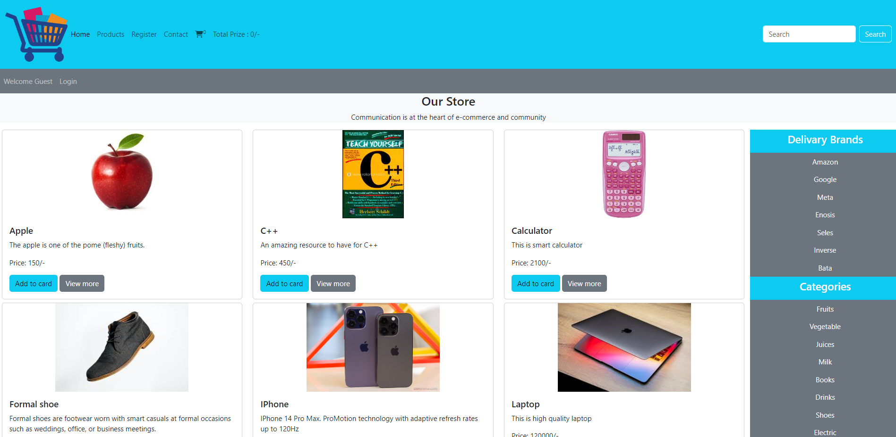
Home Page-1

Slide 8
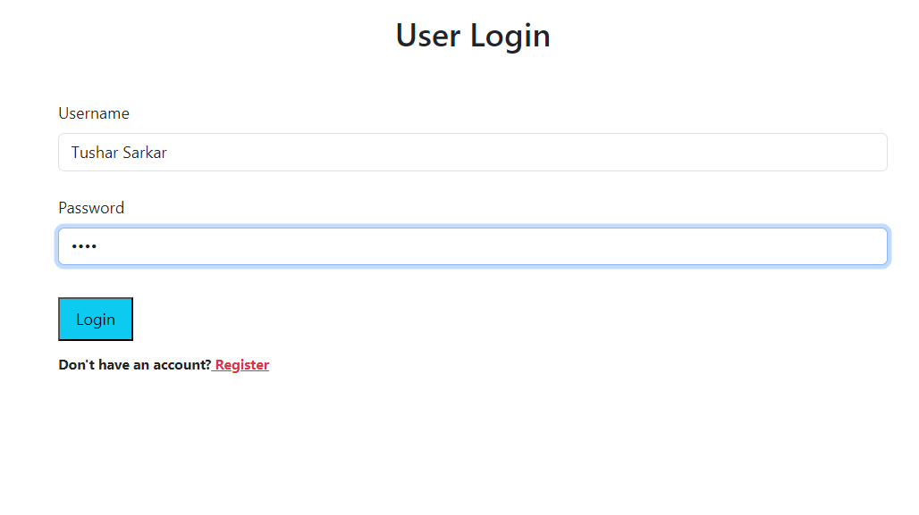
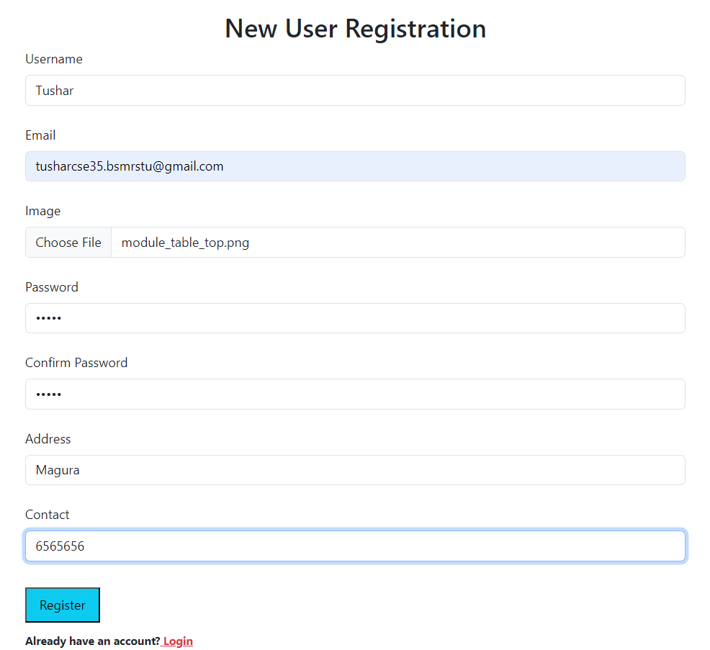
Login & Registration Page

Slide 9

Home Page-2

Slide 10
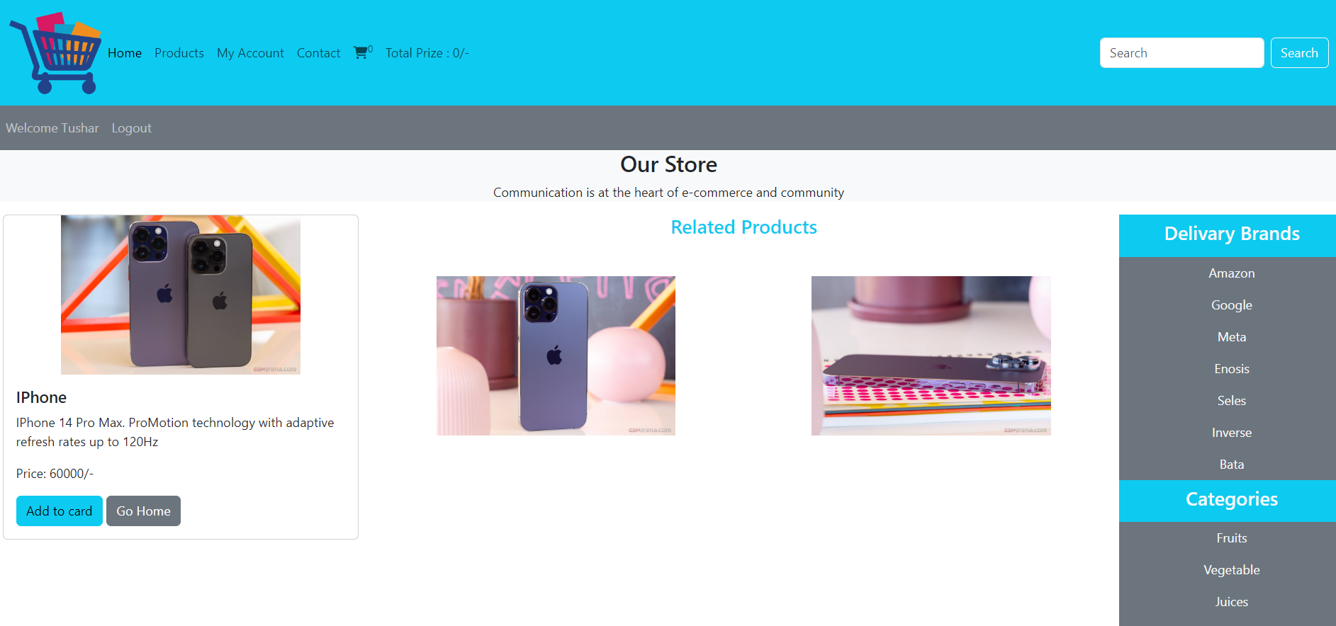
View Product

Slide 11
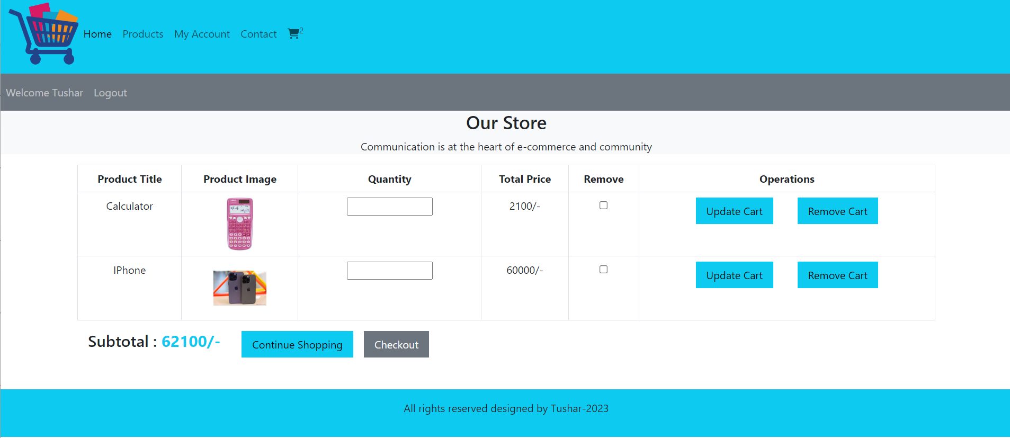
Cart

Slide 12
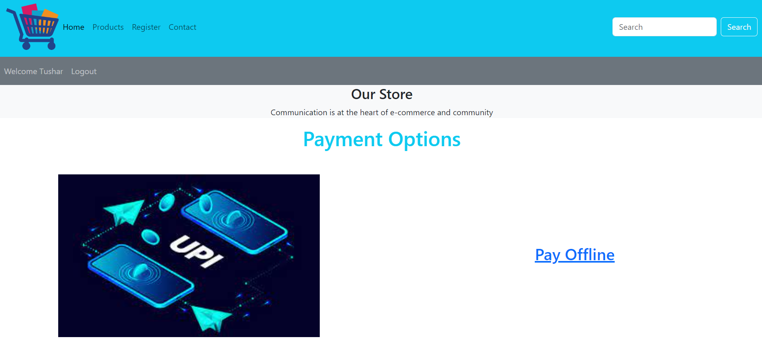
Payment

Slide 13
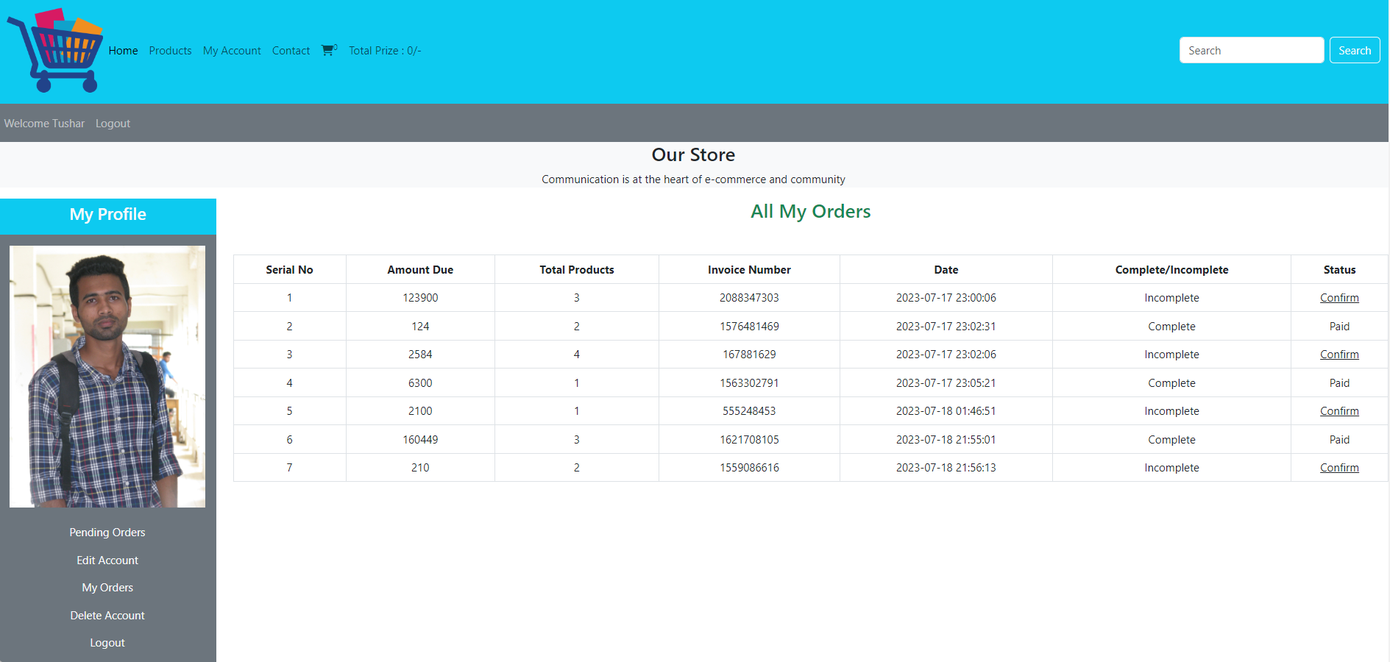
Profile

Slide 14
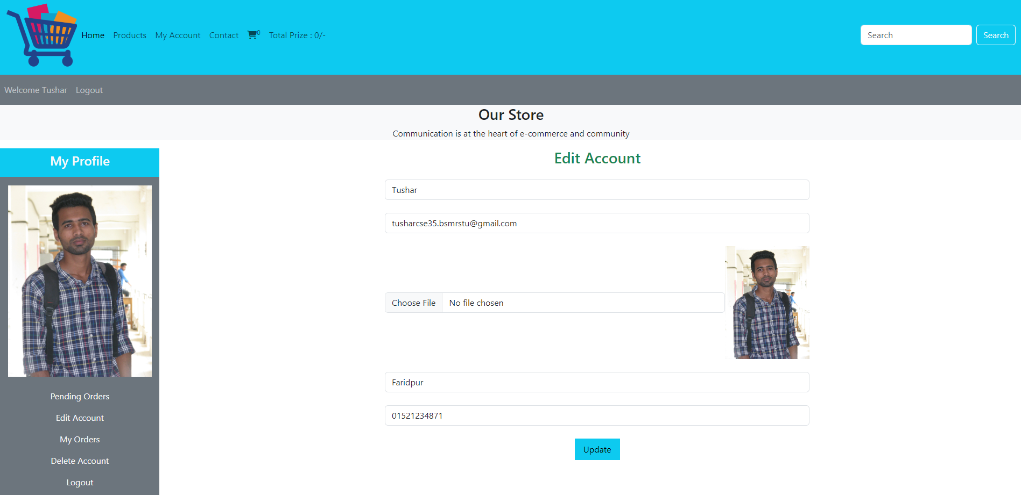
Edit Account

Slide 15
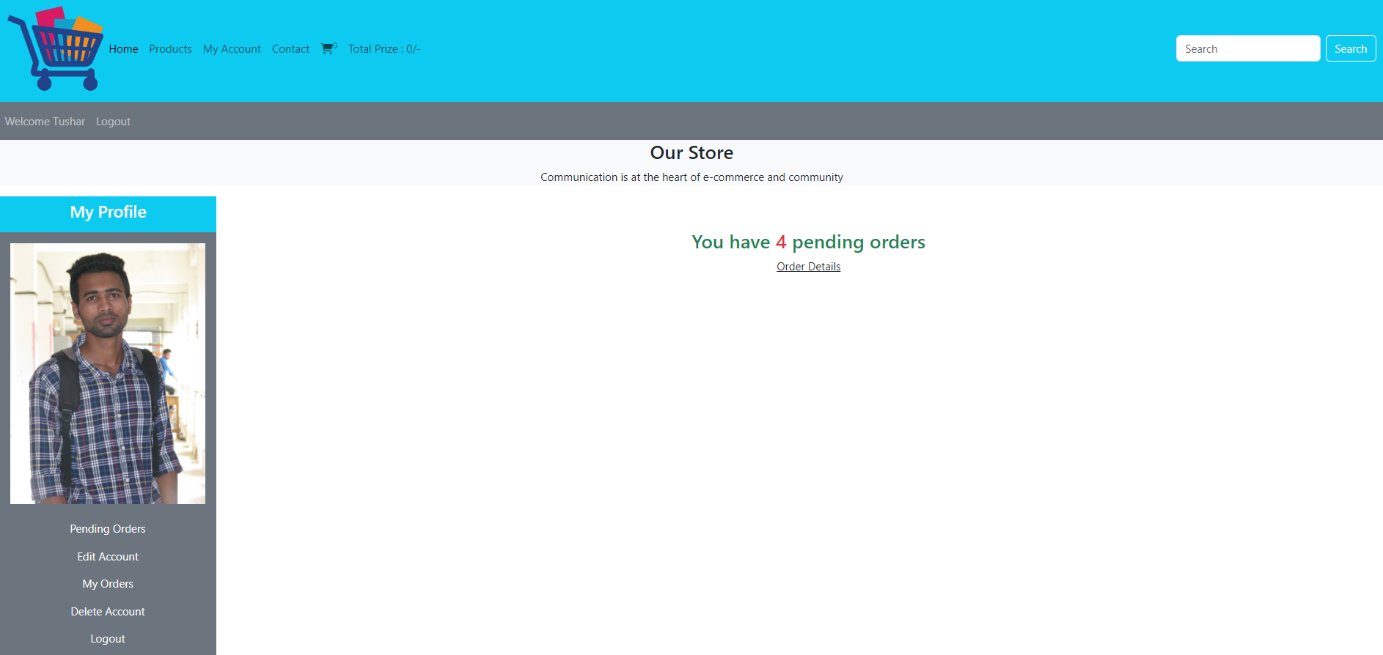
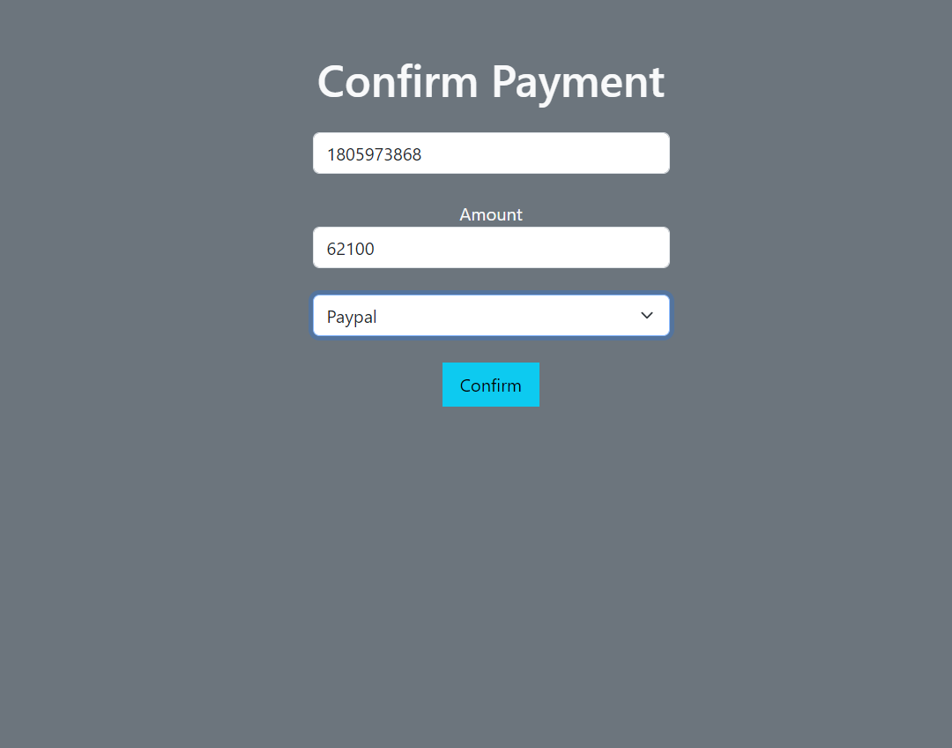
Pending Order & Payment

Slide 16
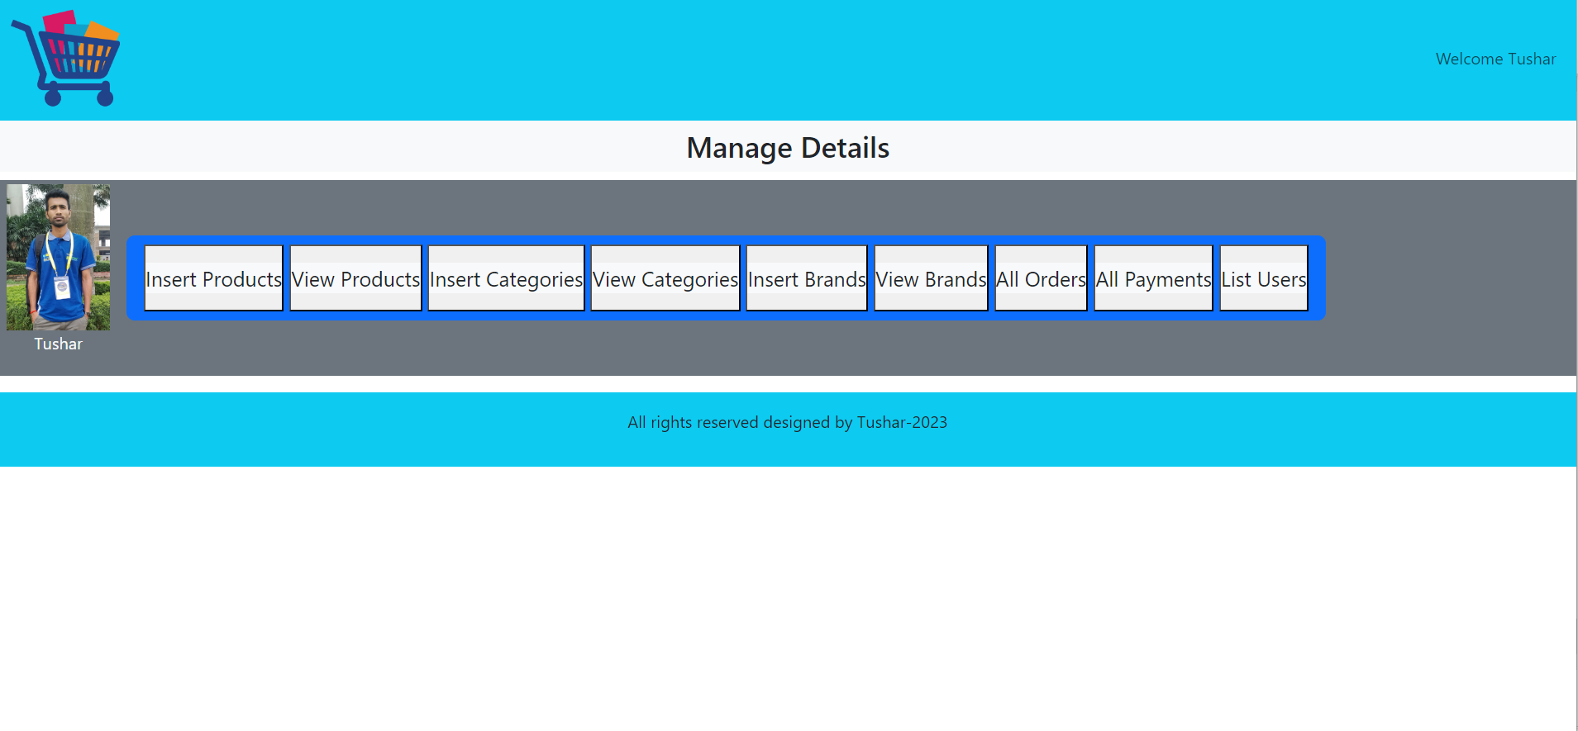
Admin Panel Mange

Slide 17
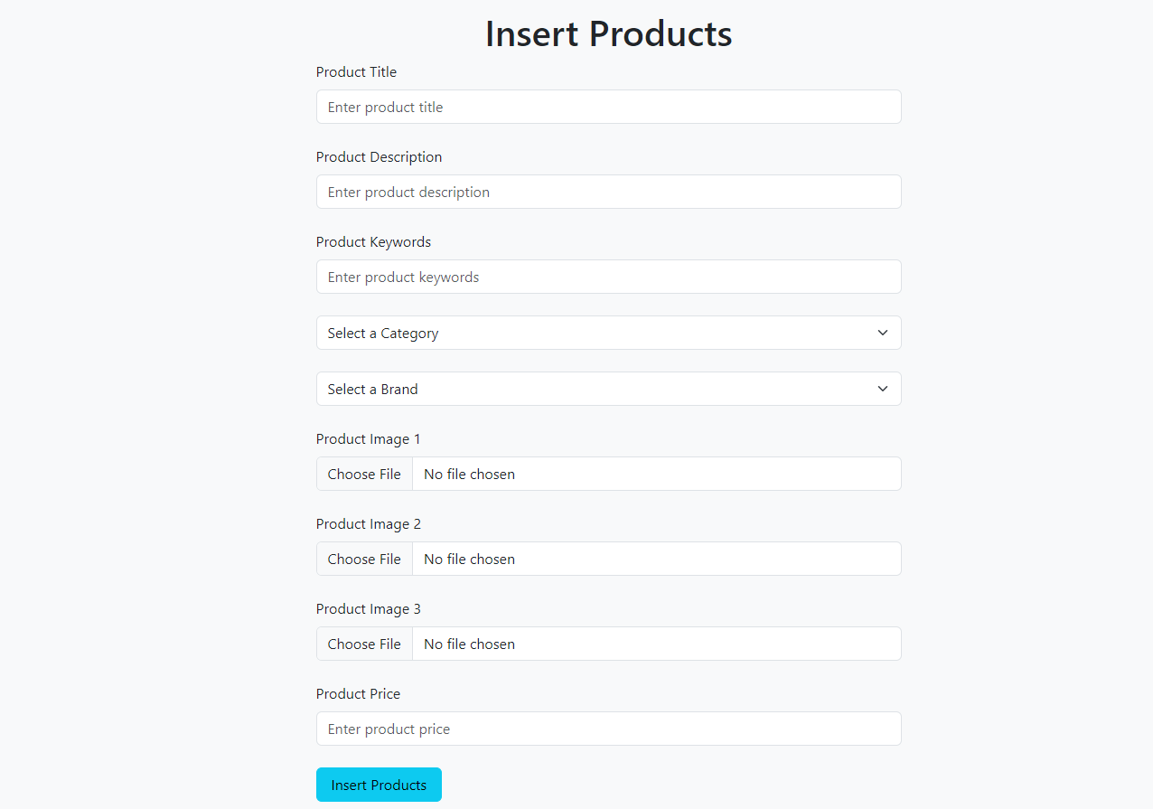

Slide 18
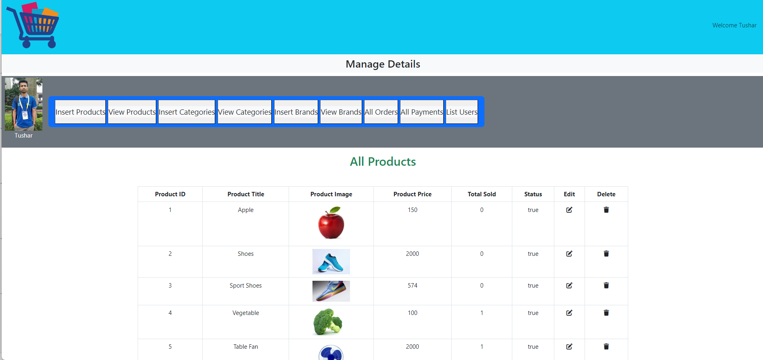
View Product

Slide 19
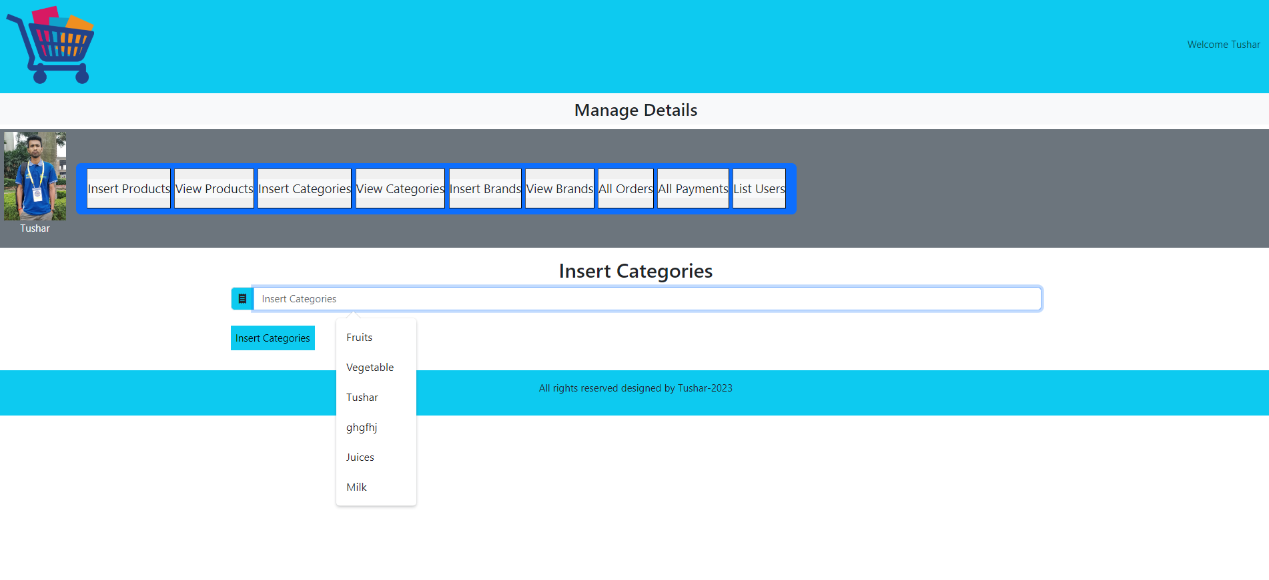
Insert Category

Slide 20
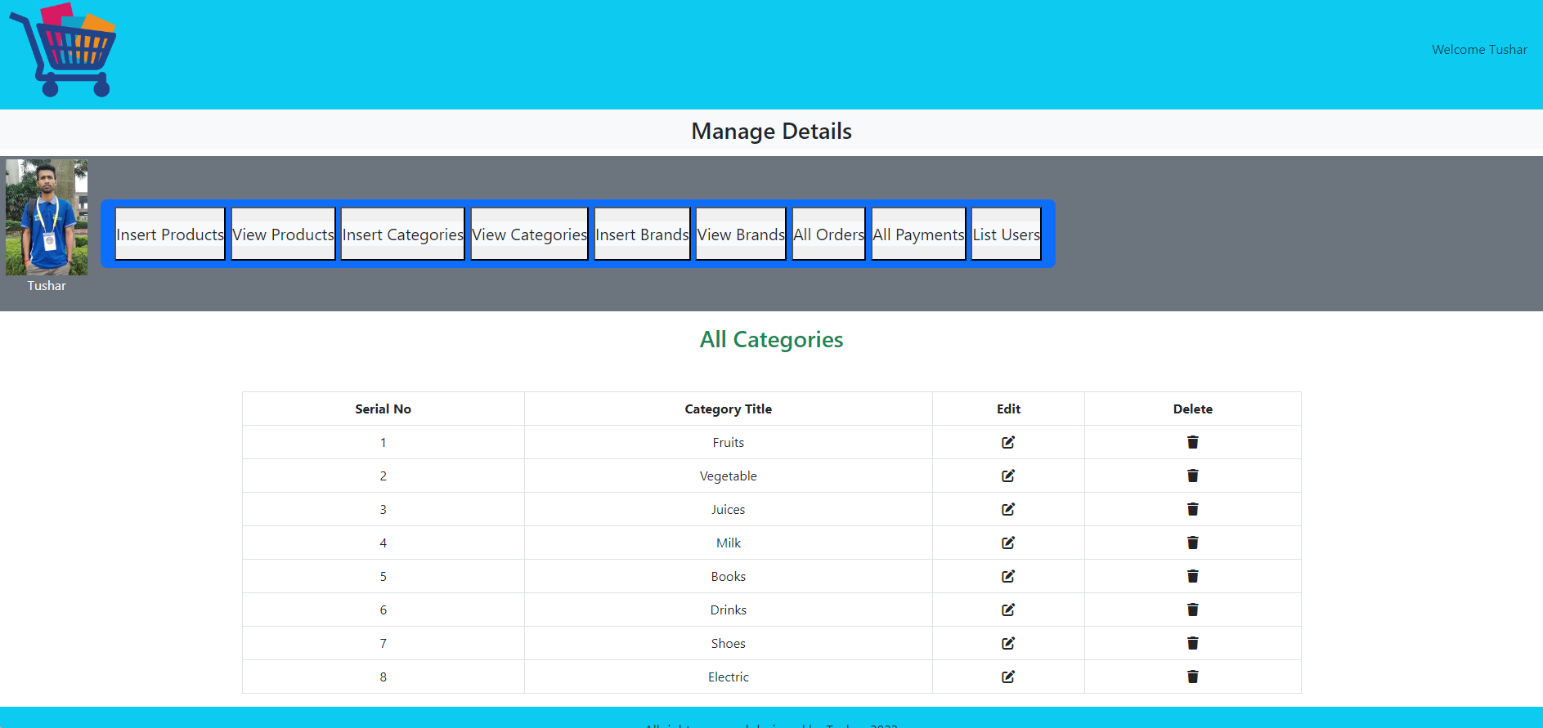
View Category

Slide 21
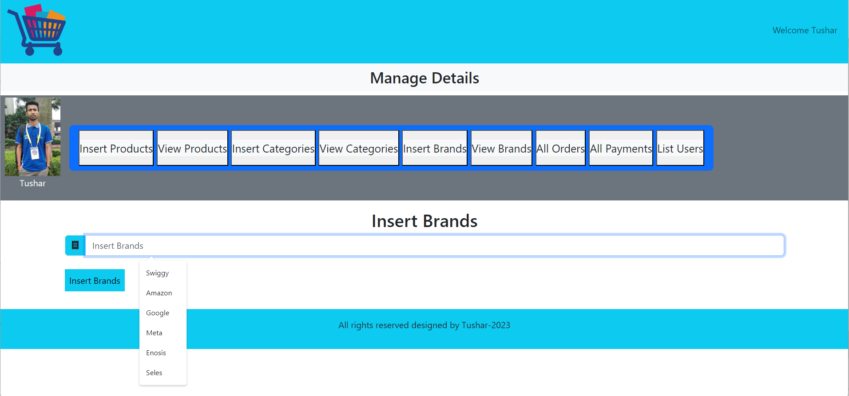
Insert Brand

Slide 22
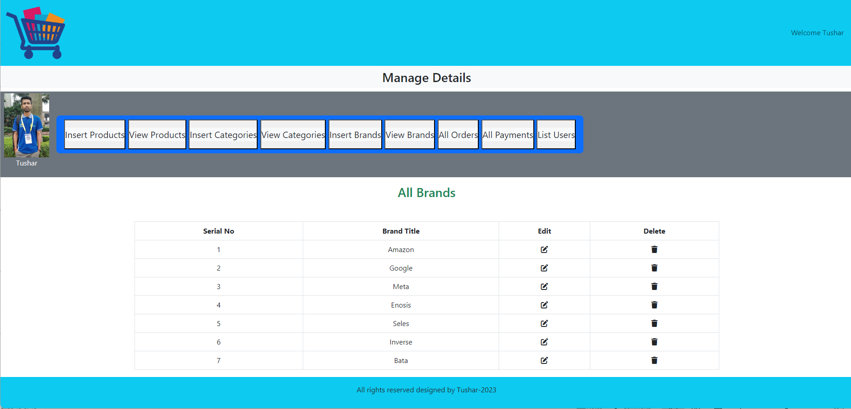
View Brand

Slide 23
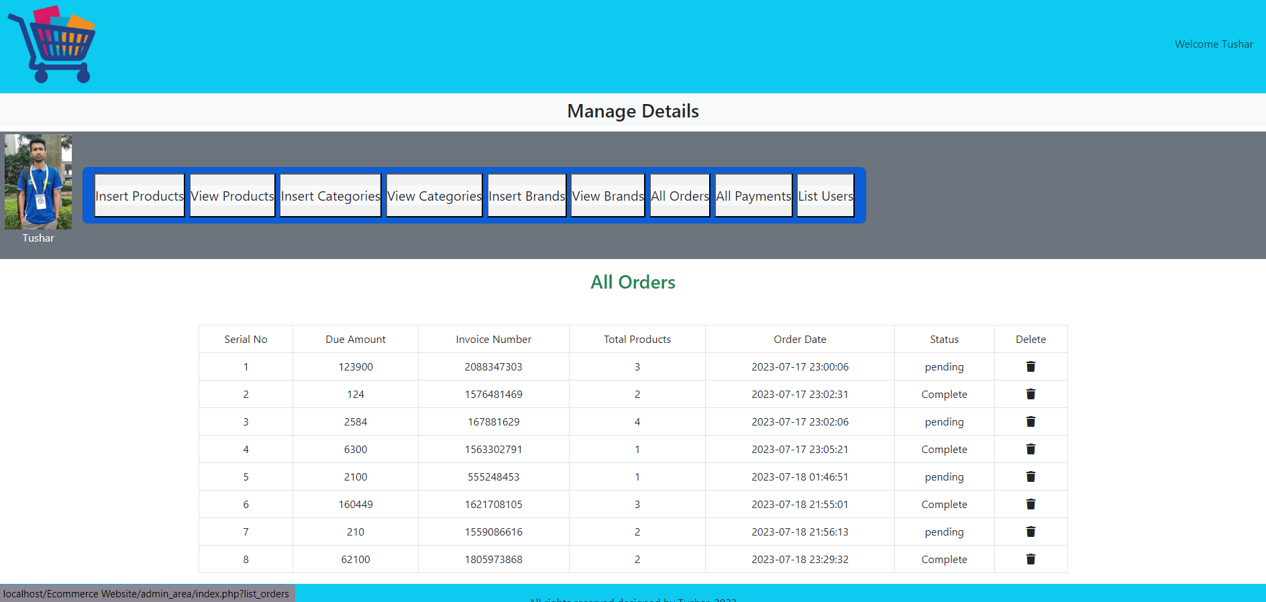
All Orders

Slide 24
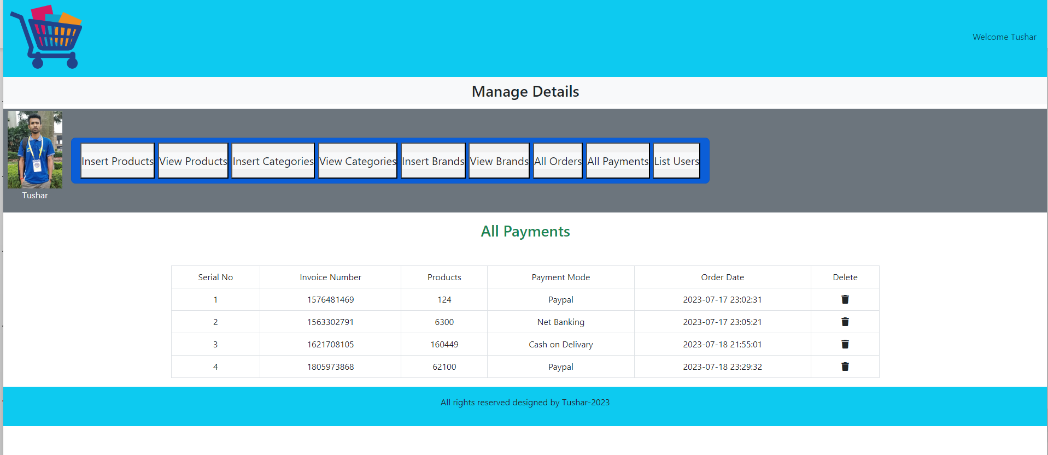
All Payment

Slide 25
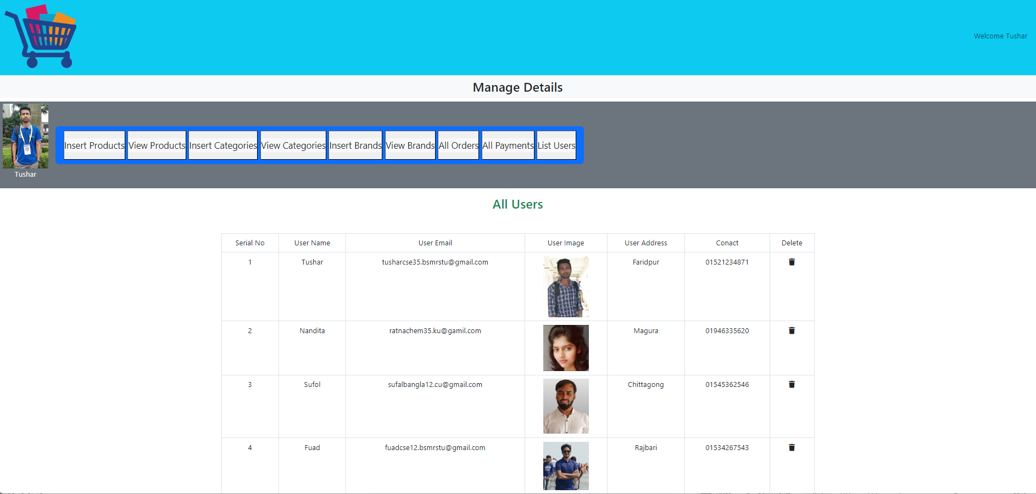
List Users

Slide 26
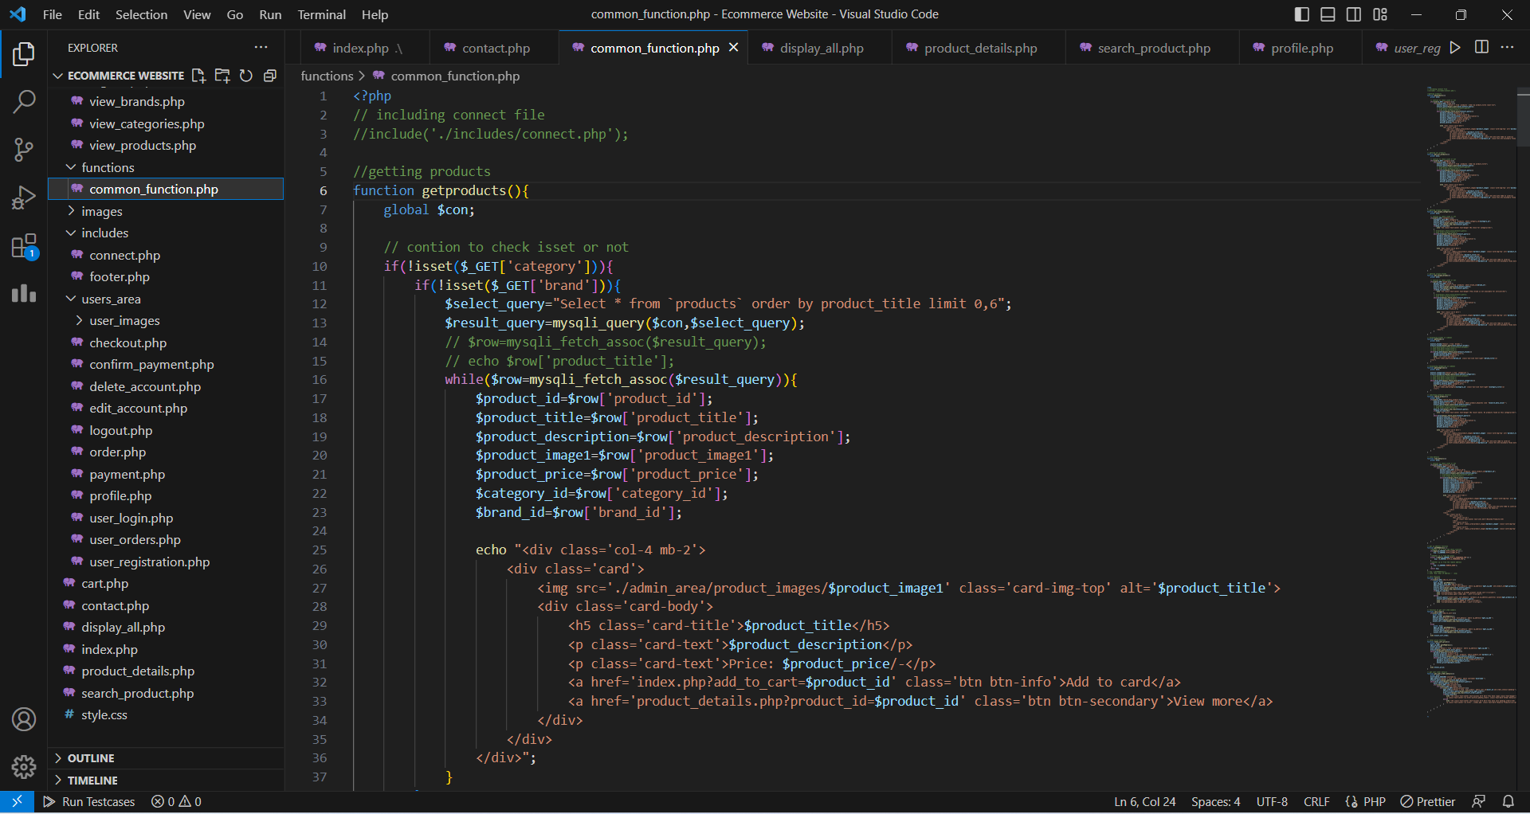
Code Sample

Slide 27
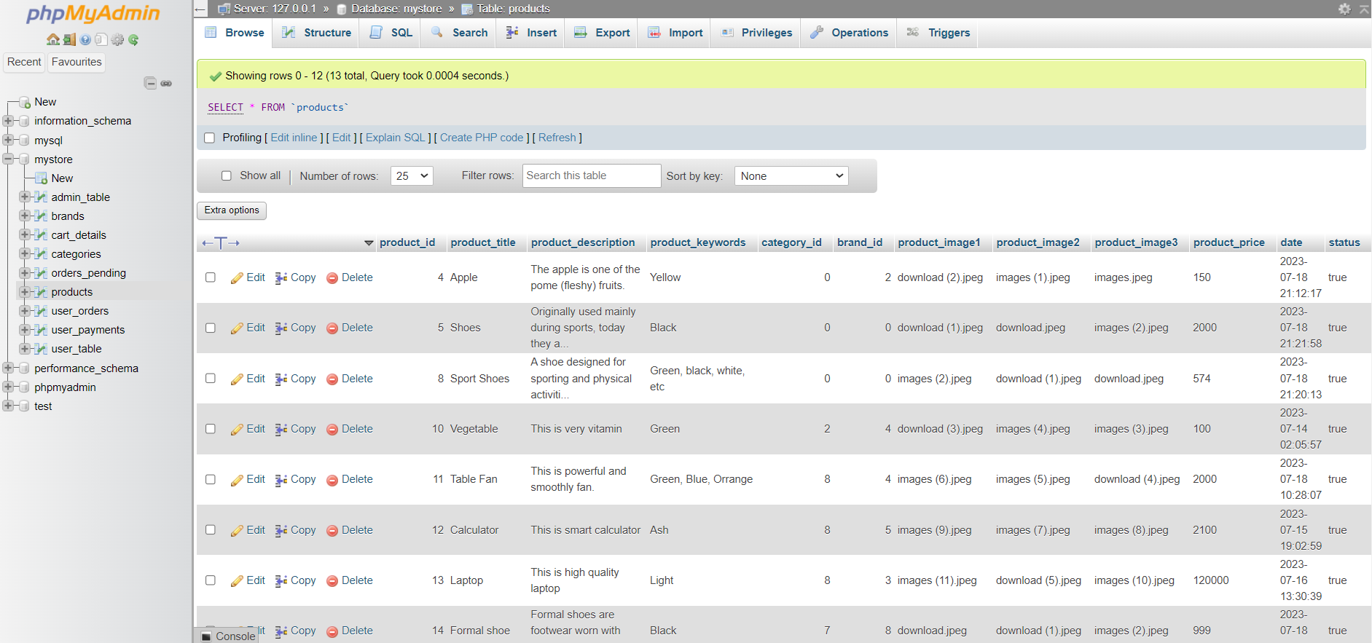
MySQL Server

Slide 28
Future Plan
I will improve this project in the future. So that the user can easily use .
We can run the entire system in any operating system and also we have an android application of this entire system.
Update payment system.
Upgrading so that users can upload products
Update Admin panel.

Slide 29
Conclusion
E-commerce websites have global reach, allowing businesses to expand their customer base worldwide.
Online shopping provides convenience and flexibility for consumers, enabling them to shop anytime, anywhere.
Secure payment gateways and logistics systems ensure seamless transactions.
E-commerce provides growth opportunities and scalability for businesses.
A well-designed e-commerce website gives businesses a competitive advantage in the market.

Slide 30
Thank You Everyone

